Slide 1


COMP.SEC.300
Exercise Work Presentation
MatchScores
Mehmet Onur Sahin
153374269
mehmet.sahin@tuni.fi

Slide 2
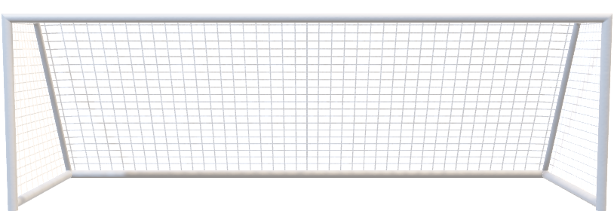

About the Project
Goal: A website allowing users to follow match scores –football only for now-

Slide 3




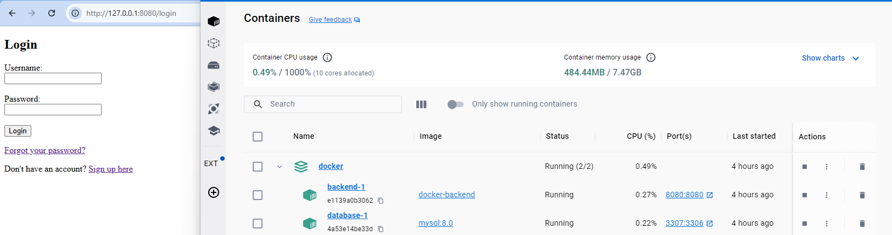
Tech Stack
Backend: Python Flask
Database: MySQL
Frontend: HTML / CSS
Containerization: Docker

Slide 4
Secure Programming Implementations
Admin-only actions are restricted to admins by checking current session user’s is_admin flag -> Broken Access Control (A01)
Passwords of users are hashed with SHA256 before saving to the database -> Sensitive Data Exposure (A02)
Parametrized queries are used -> SQL Injection (A03)
Form values are input-validated before calling any function on them -> Improper Input Validation (CWE-20)

Slide 5
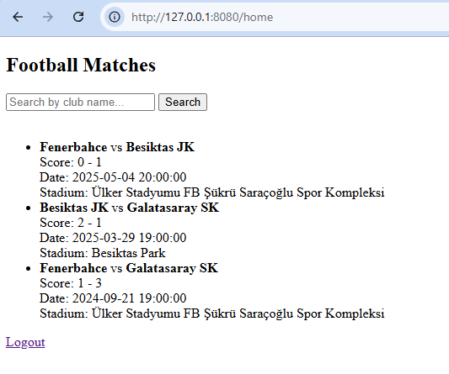
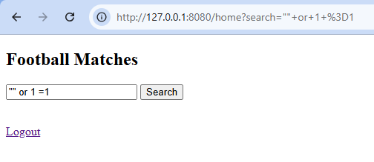
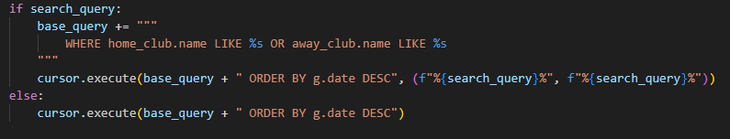
Testing the Implementations
All implementations are tested manually
SQL Injection:

Slide 6
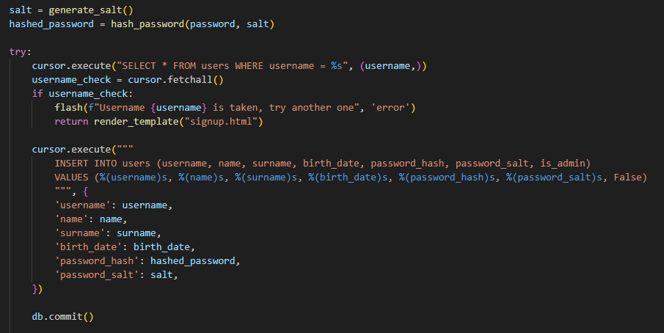
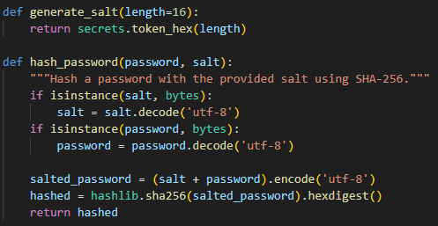
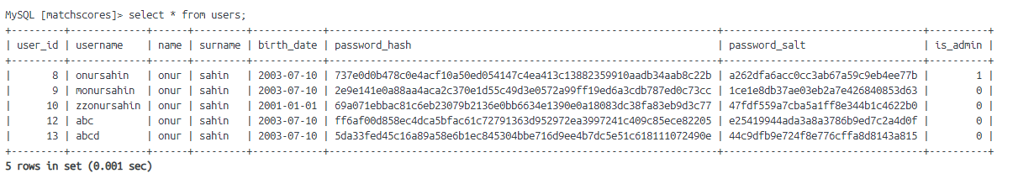
Sensitive Data Exposure:
signup.py
password_utils.py
Users table in the database

Slide 7
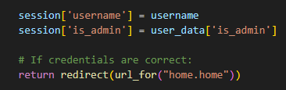
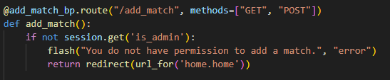
Broken Access Control:
login.py
add_match.py
…
is_admin flag checking in each action requiring administration

Slide 8
Thank you for listening to me!

